Slide 1

Generative AI in education: catalyst or constraint?
Insights from genial to inform higher education policy
Dr. Francesca Panero, Dr. Dorottya Sallai, Dr. Marcos Barreto
(on behalf of the GENIAL team)
Department of Statistics / Data Science Institute
Department of Management / School of Public Policy
Beveridge 2.0: AI and Data Science for Public Policy Symposium
08 May 2024

Slide 2
Outline
Technology (including AI) in education
GENIAL project and selected results
Existing policies and guidelines on AI in Education
Our "suggestions"

Slide 3







Educational technology
How were they adopted?
What policies and guidelines were/are in place?
1920
Radio broadcast [1]
1951
TV broadcast USA [2]
1970s
TV broadcast UK [2]
1980s
1996
2005
2018
Mainframes and PCs, mostly for school adm., later for education
Moodle [5]
StackOverflow [7]
2008
Reddit [6]
Calculators [3]
2001
IntelliSense (code completion)
Gamification [4]
Chatbots became popular [8]
2022
MOOCs
[9]

Slide 4
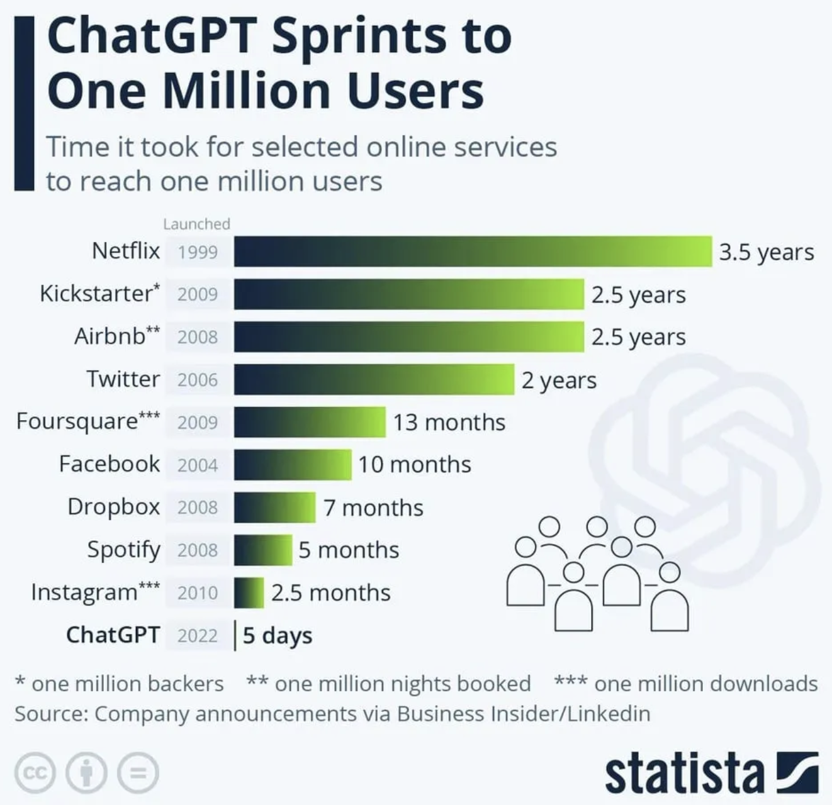

Skyrocket adoption
AI in education
Why is it different now?
Generative AI
harms vs capabilities

Slide 5
Opportunities and challenges
Area | Opportunities | Concerns
Social Sciences | Text summarisation, paper outline, brainstorming, edit feedback Improve metacognitive strategies | Loss of writing as a method and blurry of authorship Biased citations Shortcuts vs limited ability of instructors to verify original work
STEM | Synthetise code for data analysis / visualisation Dialogue with LLMs about specific topics + self-assessment of the learning process | Overconfidence Shortcut learning objectives
Programming | Simplify complex code structure Encourage best practices for software engineering Democratisation of programming | Expected programming skills vs motivation to learn Ability to navigate human+AI code bases Underspecification of assignments to outwit models
Cornell University. Generative artificial intelligence for education and pedagogy [10]

Slide 6


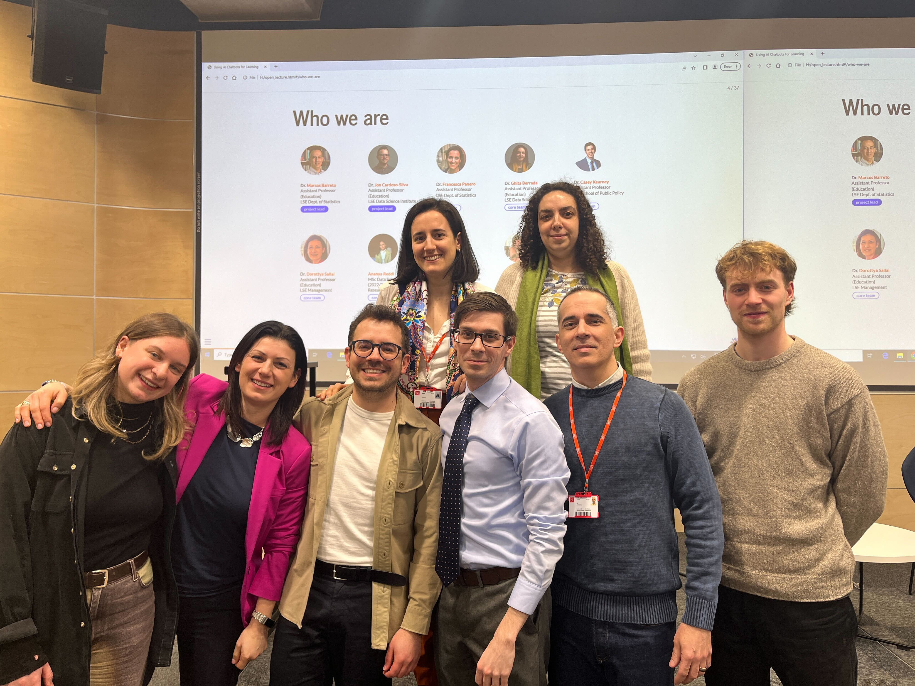


Focus group to understand students' experience and perception on using generative AI tools in their learning process.
Collaborative project: Statistics, Data Science Institute, Management, and School of Public Policy.
Timeline: July 2023 – April 2024
Funding: Eden Centre
Team:
https://lse-dsi.github.io/genial/
Up: Francesca, Ghita, Ananya (picture), Leonard (picture)
Bottom: Sara, Dorottya, Jonathan, Casey, Marcos and Maxwell

Slide 7
Case studies:
https://lse-dsi.github.io/genial/
Case study | Autumn Term (2023) | Winter Term (2024)
Undergraduate courses | DS105 – Data for Data Science DS202 – Data Science for Social Scientists ST207 – Databases | DS105 – Data for Data Science DS202 – Data Science for Social Scientists MG317 – Leading Organisational Change
Postgraduate courses |  | ST456 – Deep Learning PP422 – Data Science for Public Policy MG4B7 – Leading Organisational Change
Cohorts: 48 students / 159 students

Slide 8
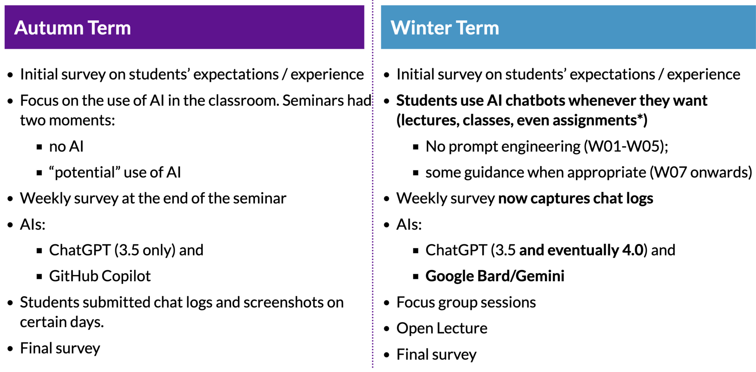
Methodology & data collection
https://lse-dsi.github.io/genial/

Slide 9
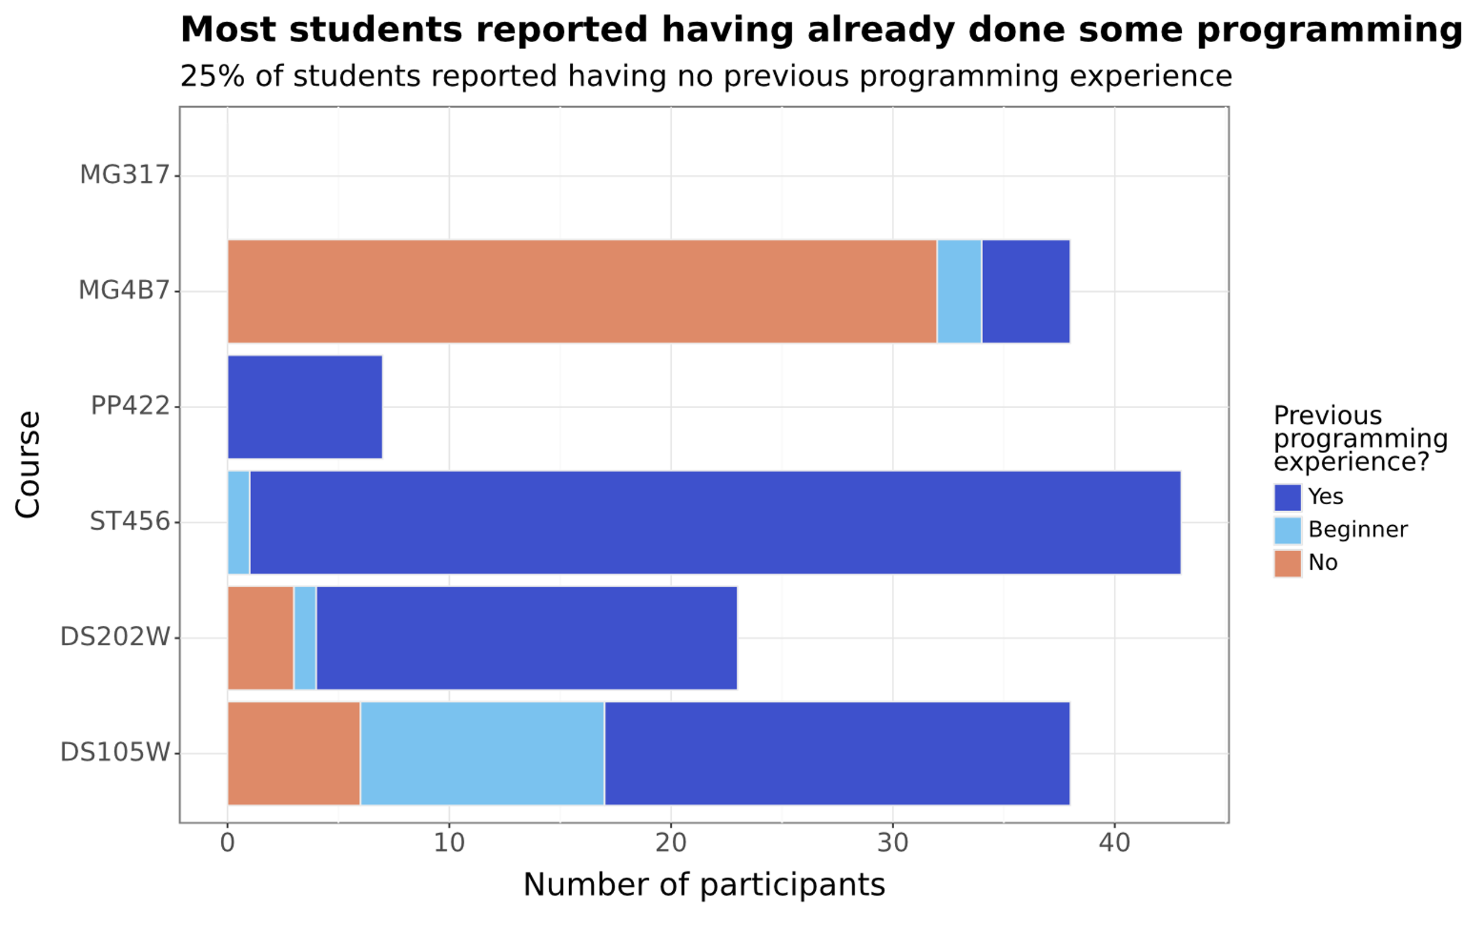
GENIAL initial survey results: the student experience

Slide 10
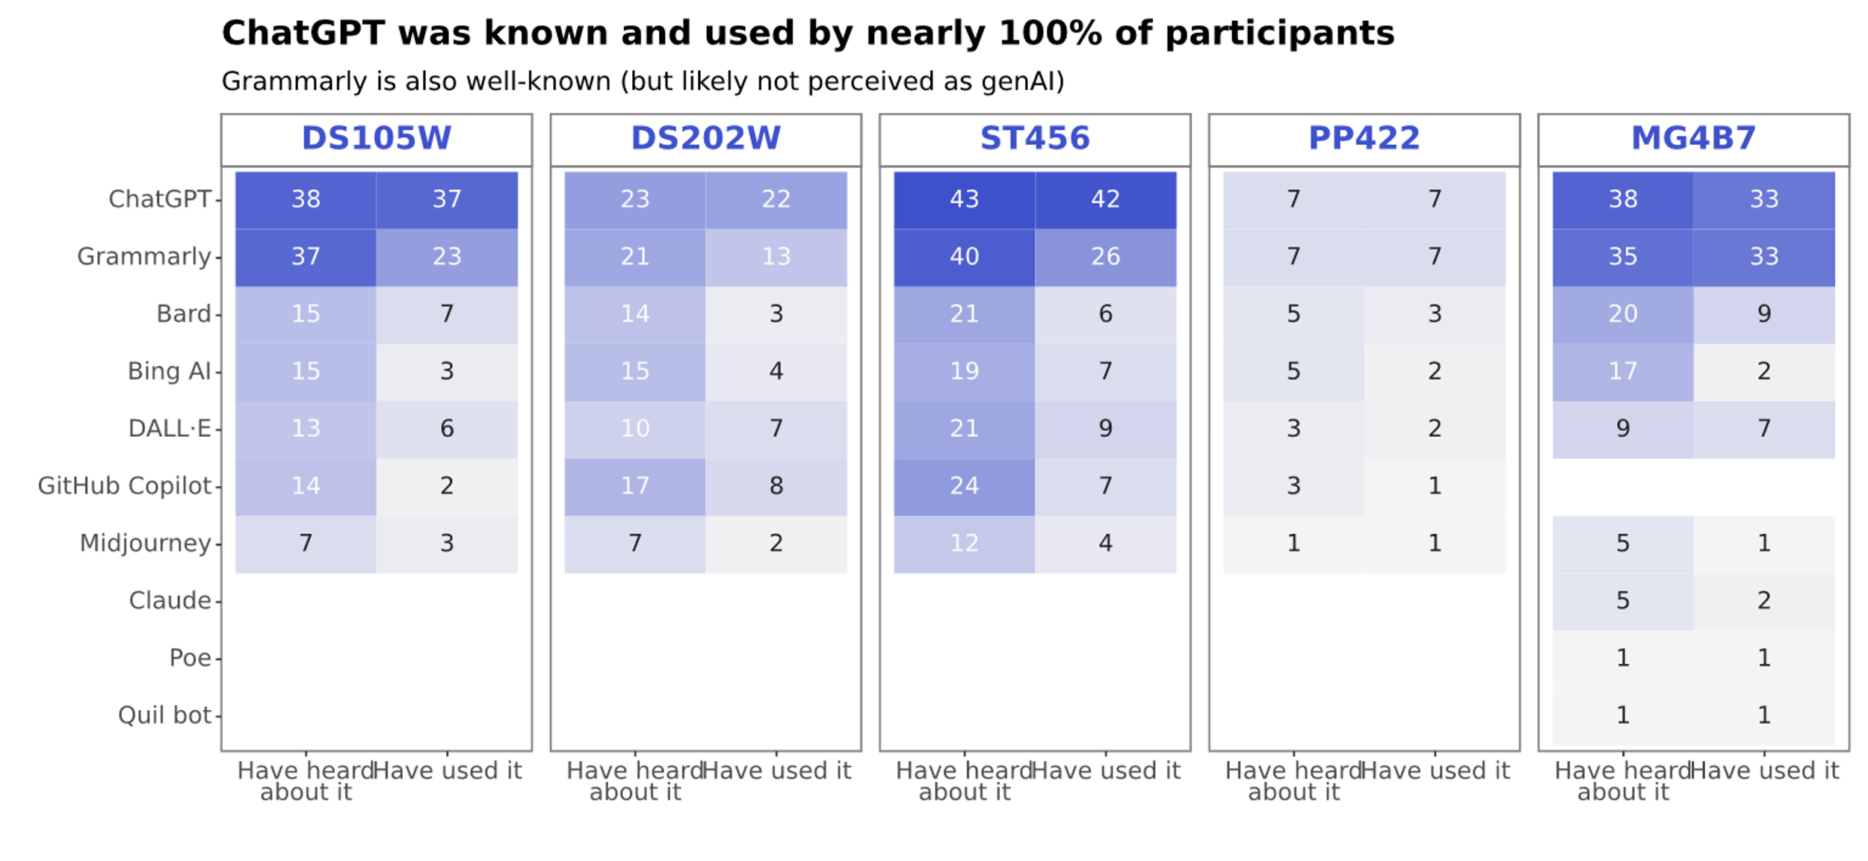
GENIAL initial survey results: the student experience

Slide 11
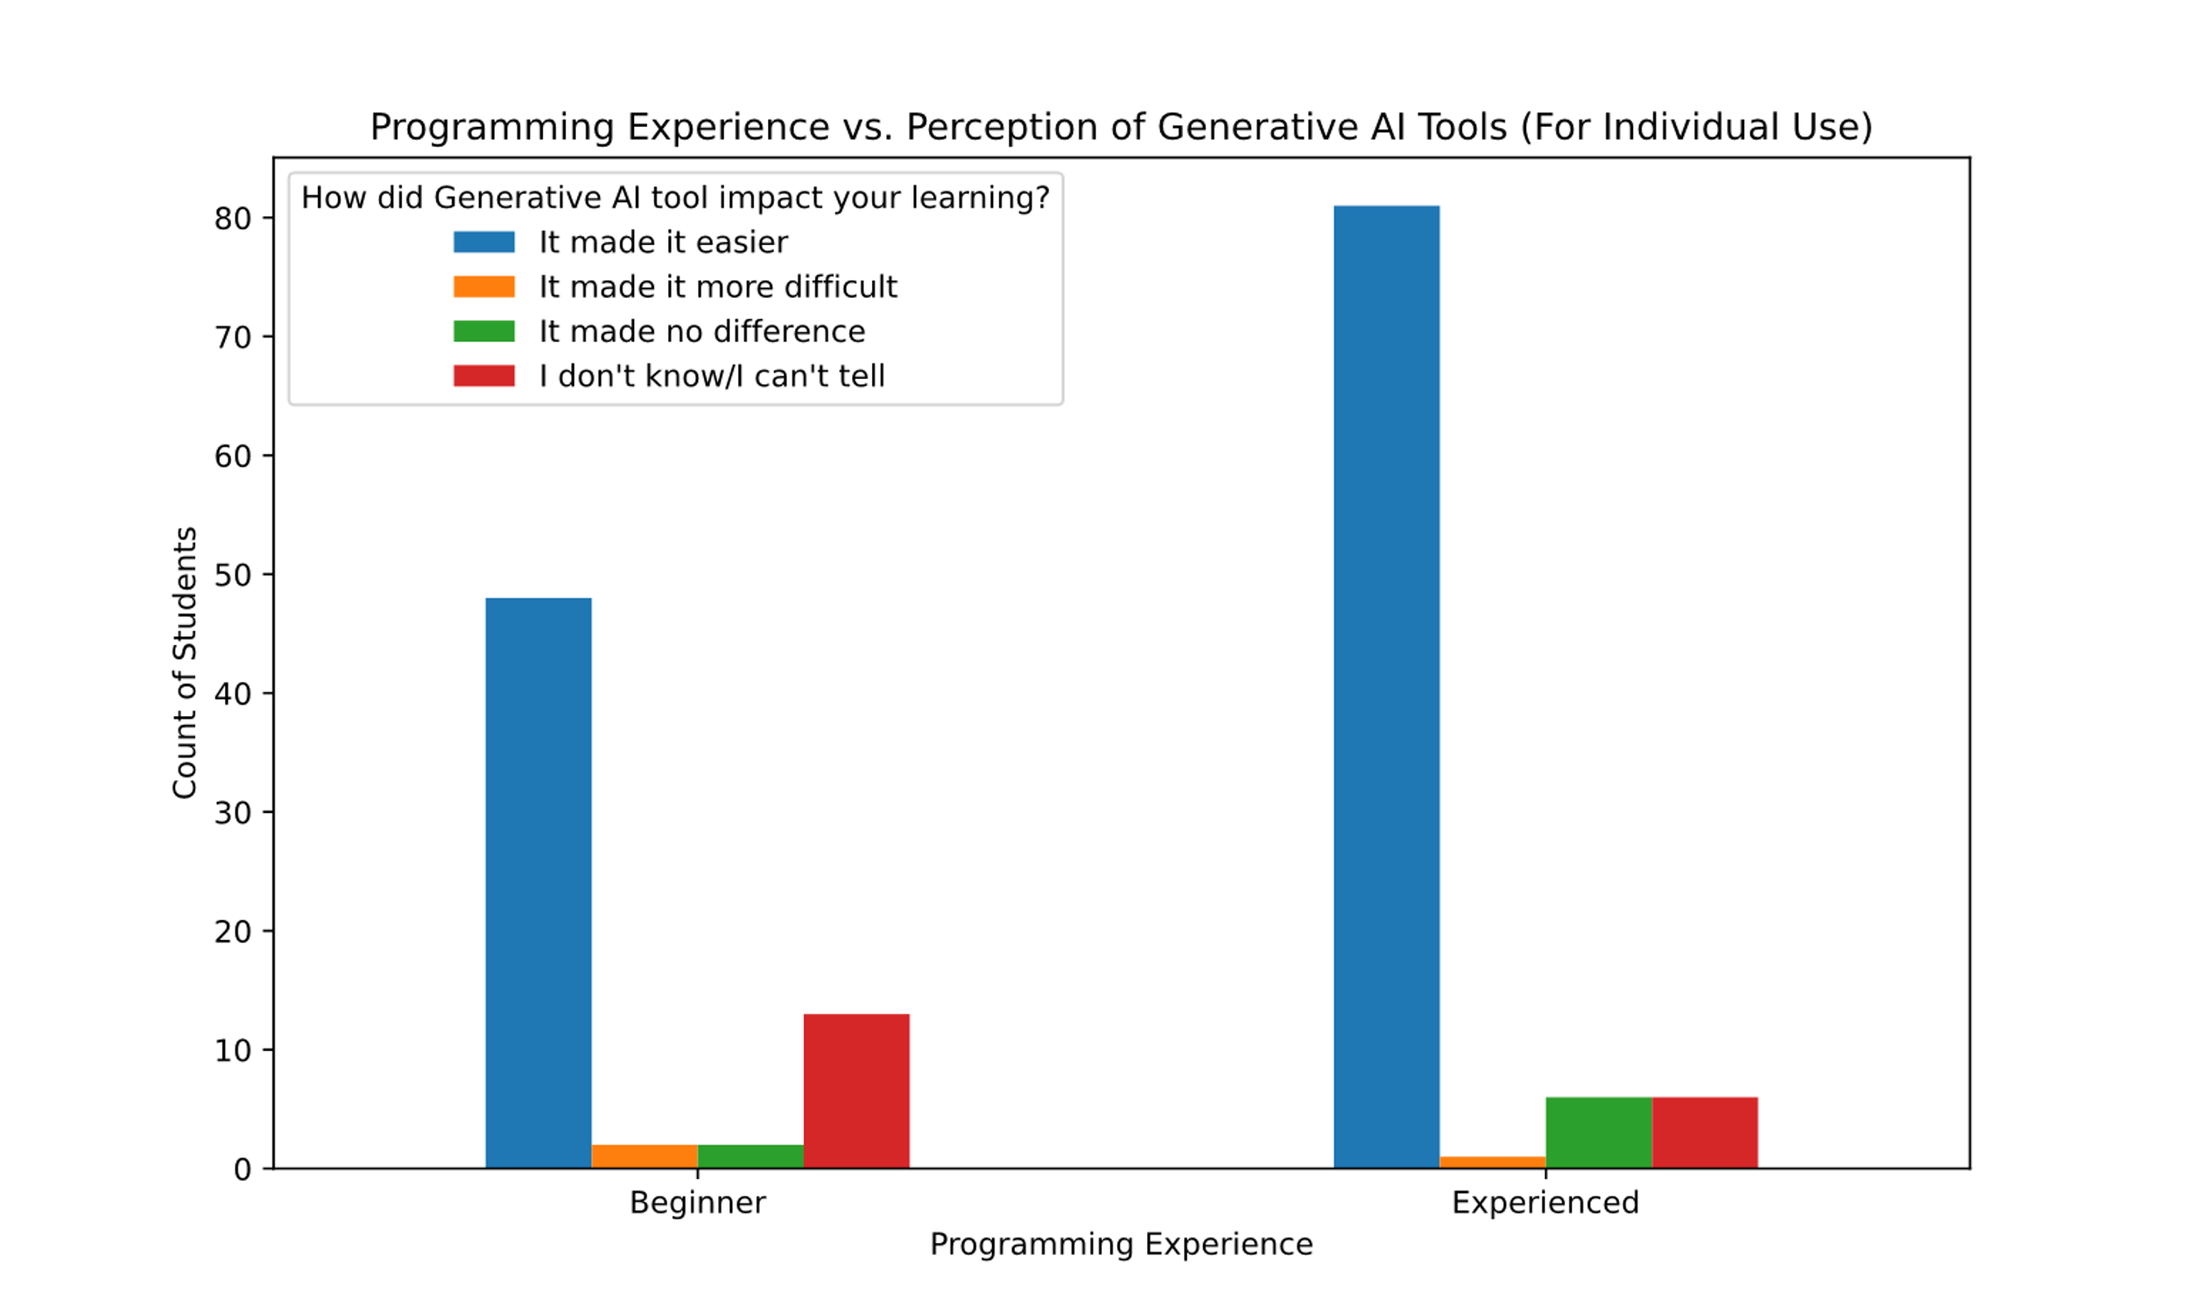
GENIAL initial survey results: the student experience

Slide 12
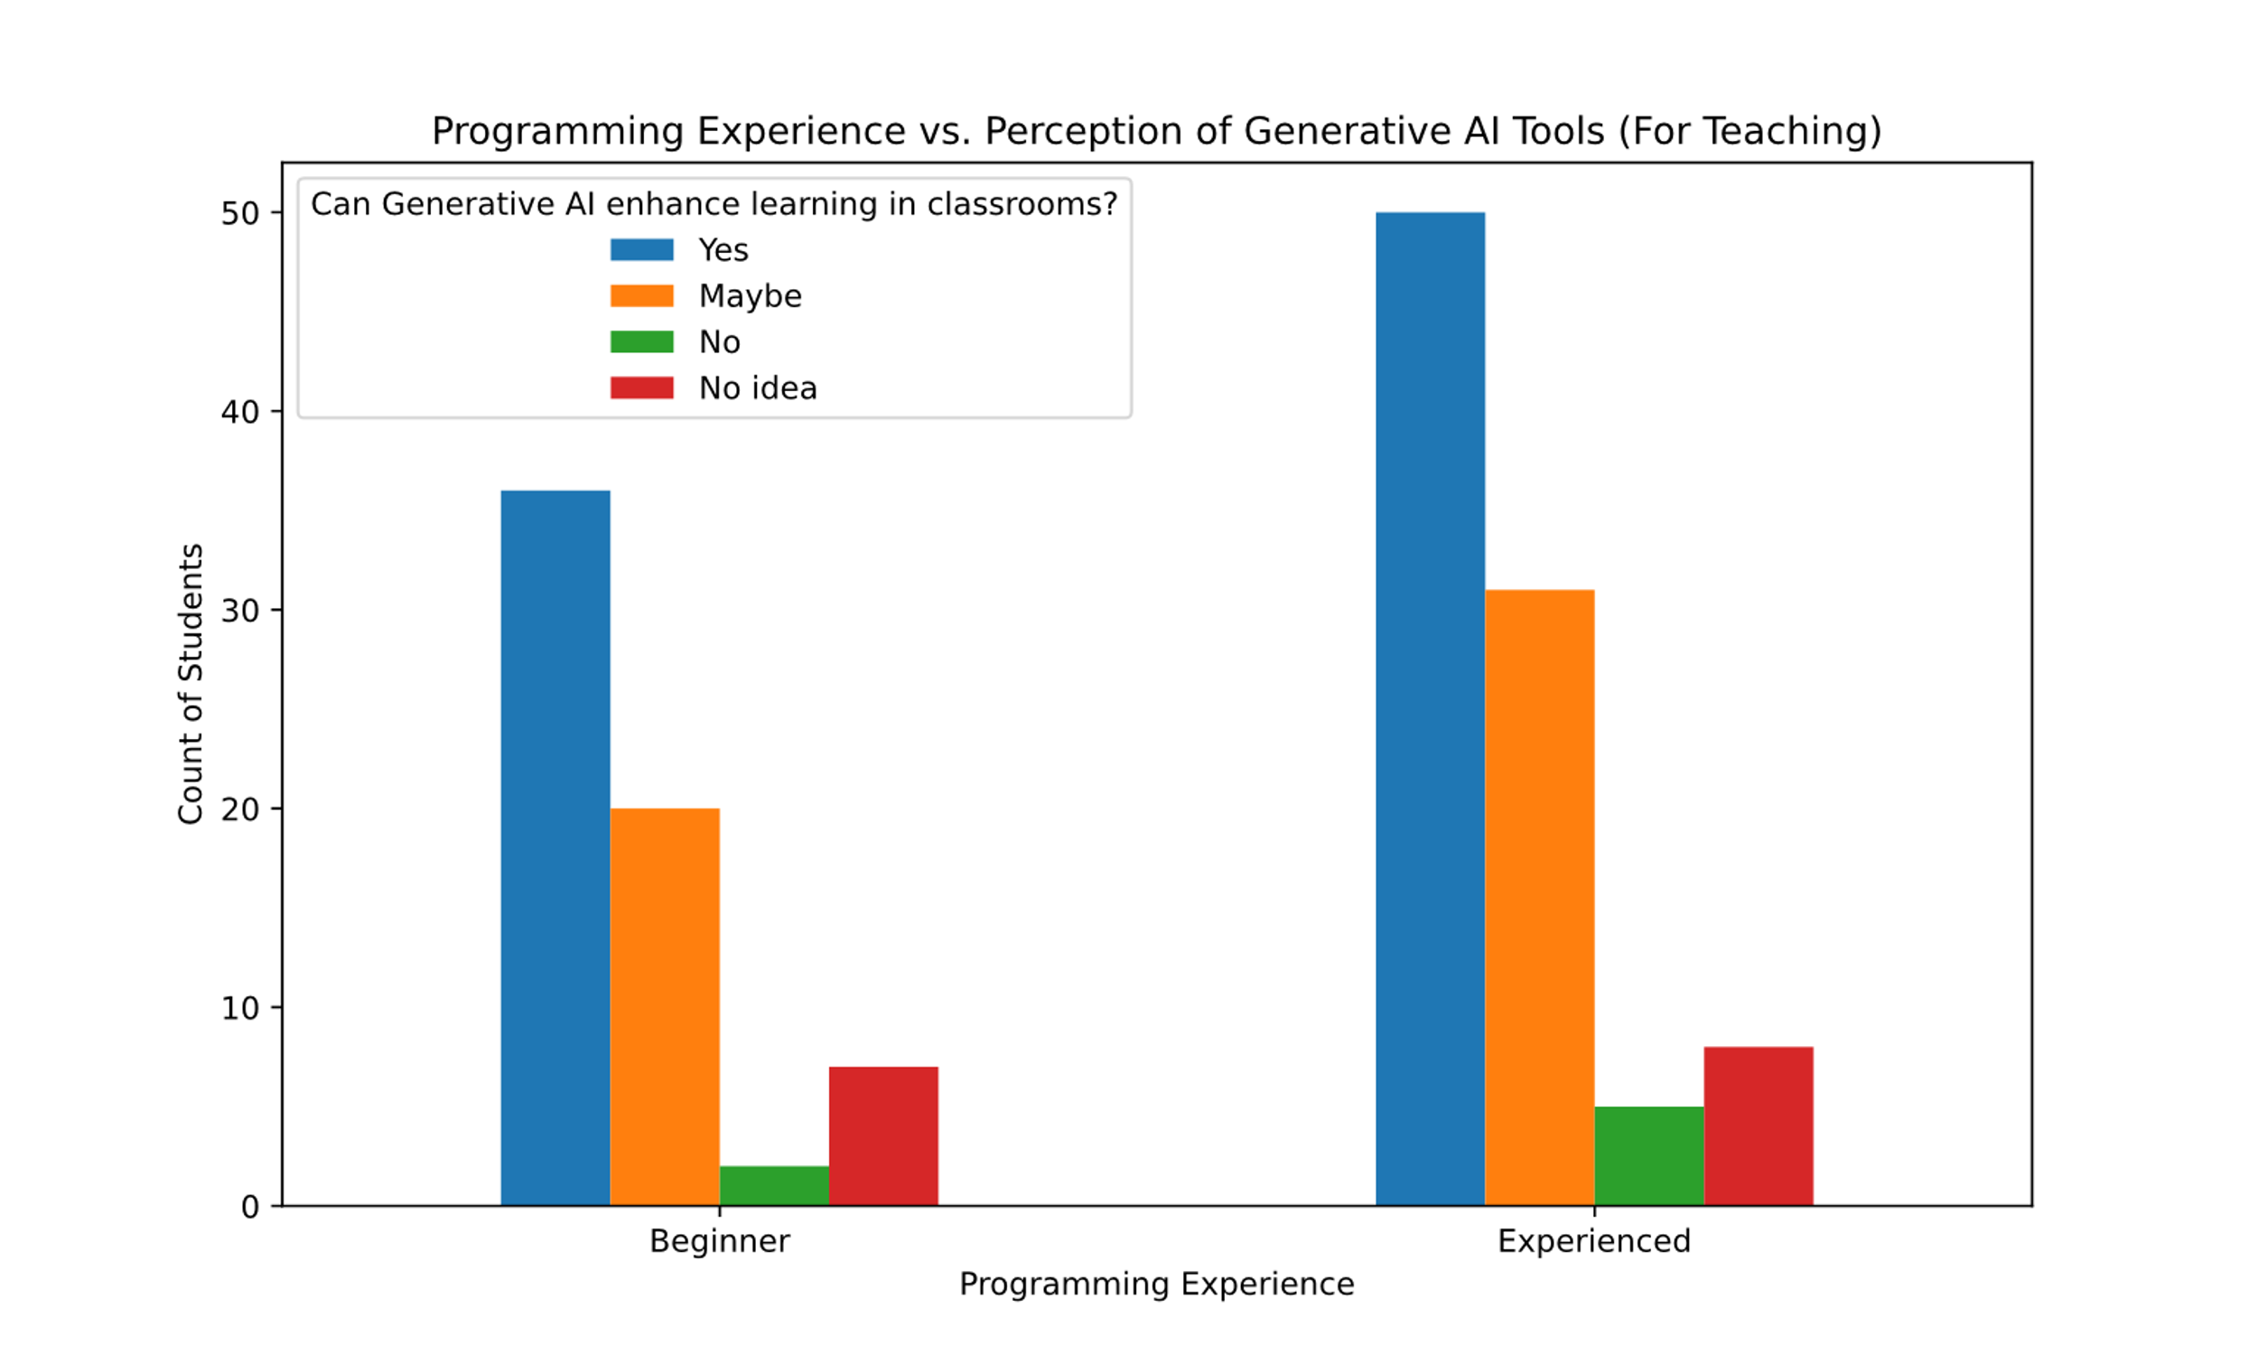
GENIAL initial survey results: the student experience

Slide 13
Chat logs from GENIAL: examples from quantitative MSc course
The course policy
No specific restrictions but with a requirement to track key stages/tools utilised and reference use of generative AI tools. In all submissions in which you use Generative AI, you must cite its usage and include the chat log in the assessment submission. Failing to cite the use of Generative AI is academic misconduct.
Case study on deep learning assignments
2 individual summative assessments (take-home problem sets)
Mix of coding, Maths and interpretation questions
Two weeks to complete each of them
Each worth 10% of final mark
~ 10 students (out of 90) submitted a chat log for each assignment: total of 20 chat logs
3 patterns: post assignment, coding, pre assignment

Slide 14
Chat logs from GENIAL: examples from quantitative MSc course
The validation student: consulting the bot after having attempted the exercise
This is the question: …
This is my answer: ...
What would you improve? Is the description factually accurate and precise?
Spellchecks, British English...
Pros:
Good idea to check text, usually improves the flow (important to give a draft to maintain the style/length of text)
Cons:
Might not pick up technical mistakes and reinforces students in their ideas (more on this later)

Slide 15
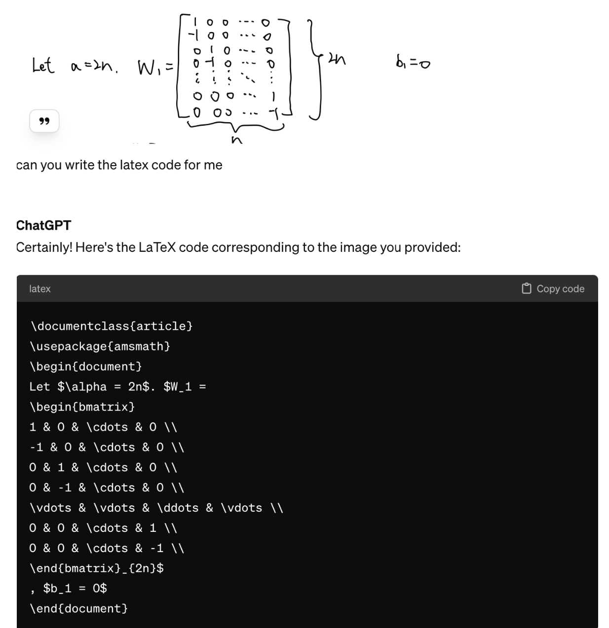
Chat logs from GENIAL: examples from quantitative MSc course
The coding student
Produce code from scratch
Debug code
Adding small bits or modify code
Ask to comment or summarise code
Producing LaTeX code (e.g. starting from pictures)
Pros:
Speeds up coding
Generally good for debugging
Cons:
Sometimes the bot gets lost
Hard to use if you have zero/limited coding knowledge

Slide 16
Chatlogs from GENIAL: examples from quantitative MSc course
Can you rewrite this code to plot with ggplot instead? Sure, here's the equivalent code using ggplot in Python: plot_loss = … plot_accuracy = … (ggplot() + plot_loss + plot_accuracy).draw()
Could you fix the error I'm getting running the above code? AttributeError: 'ggplot' object has no attribute '__radd__' The error you're encountering typically arises when trying to combine ggplot objects using the + operator in a way that is not supported. Let's refactor the code to combine the plots differently plot_loss.draw() plot_accuracy.draw()
It is only showing one chart, could you fix it? Apologies for the confusion. Let's fix the code to display both plots side by side as intended (plot_loss | plot_accuracy).draw()
I'm getting an error unsupported operand type(s) for |: 'ggplot' and 'ggplot' I apologize for the confusion. It seems I made a mistake. In plotnine, the | operator is not used for concatenating plots side by side. Instead, we can use the + operator. Let me correct that plot_loss + plot_accuracy
Getting an error 'ggplot' object has no attribute '__radd__' plot_loss.draw() plot_accuracy.draw()

Slide 17
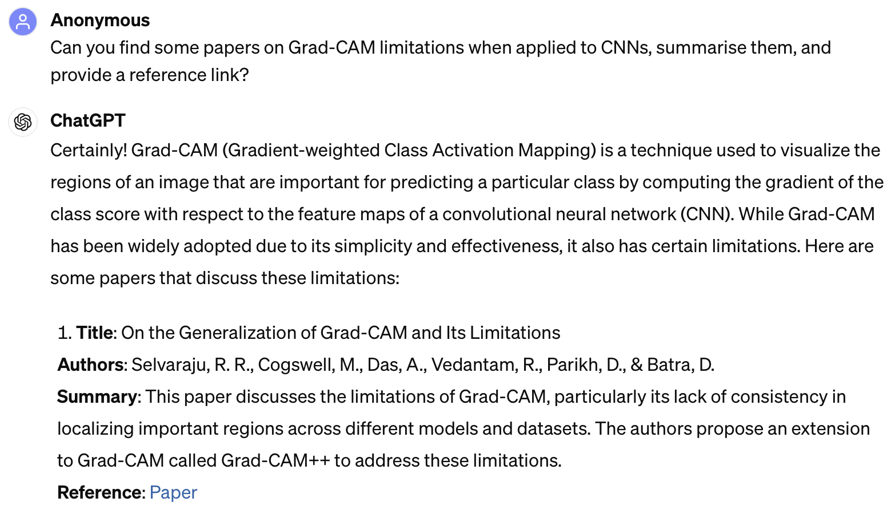
Chatlogs from GENIAL: examples from quantitative MSc course
The references type
Cons:
Makes citations up (should be better with GPT4)

Slide 18
Chat logs from GENIAL: examples from quantitative MSc course
The "I will ask anything" student: used before attempting the assignment
Substitute of book or papers
Substitute of dictionary
Substitute of search engine
Substitute of thinking?
Pro:
It can answer with very specific and extended prompts (for example specifying course context)
Cons:
Hard to check sources and compare
If the prompt is vague or not enough details/context, the bot might mislead
It might not be compliant with course policy

Slide 19

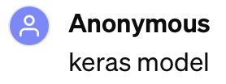




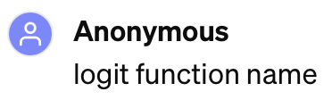

Chatlogs from GENIAL: examples from quantitative MSc course
The "I will ask anything" type: search engine
Cons:
Hard to check sources and compare

Slide 20
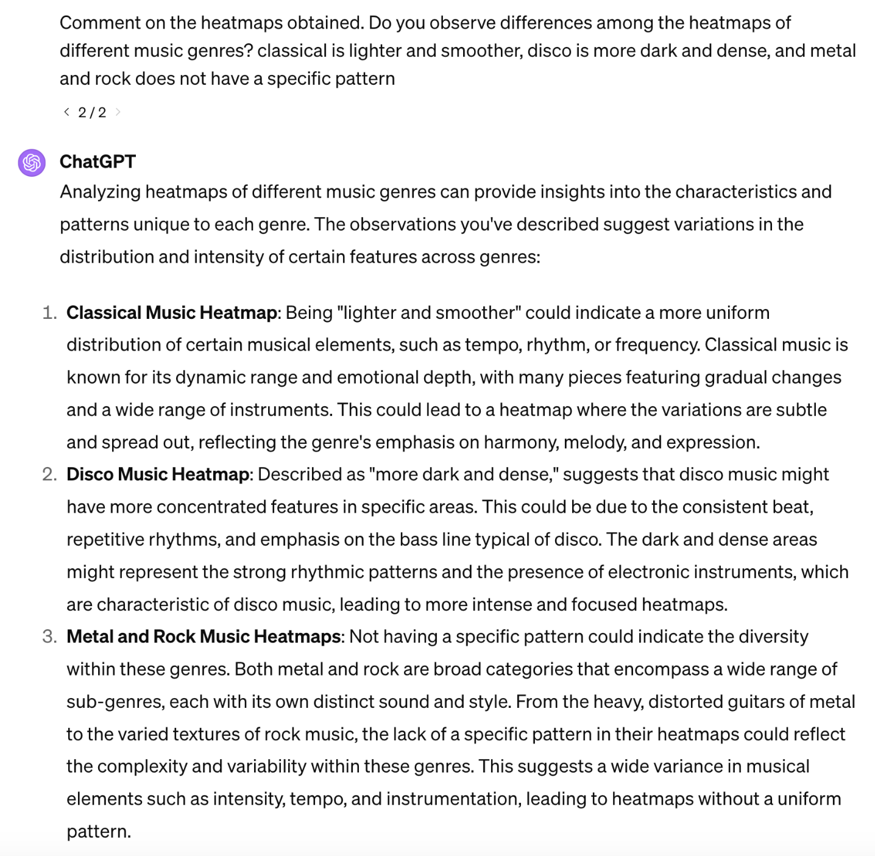
The student is trying to get a comment from pictures, but they don't include them.
The bot does not complain and comes up with an answer.

Slide 21
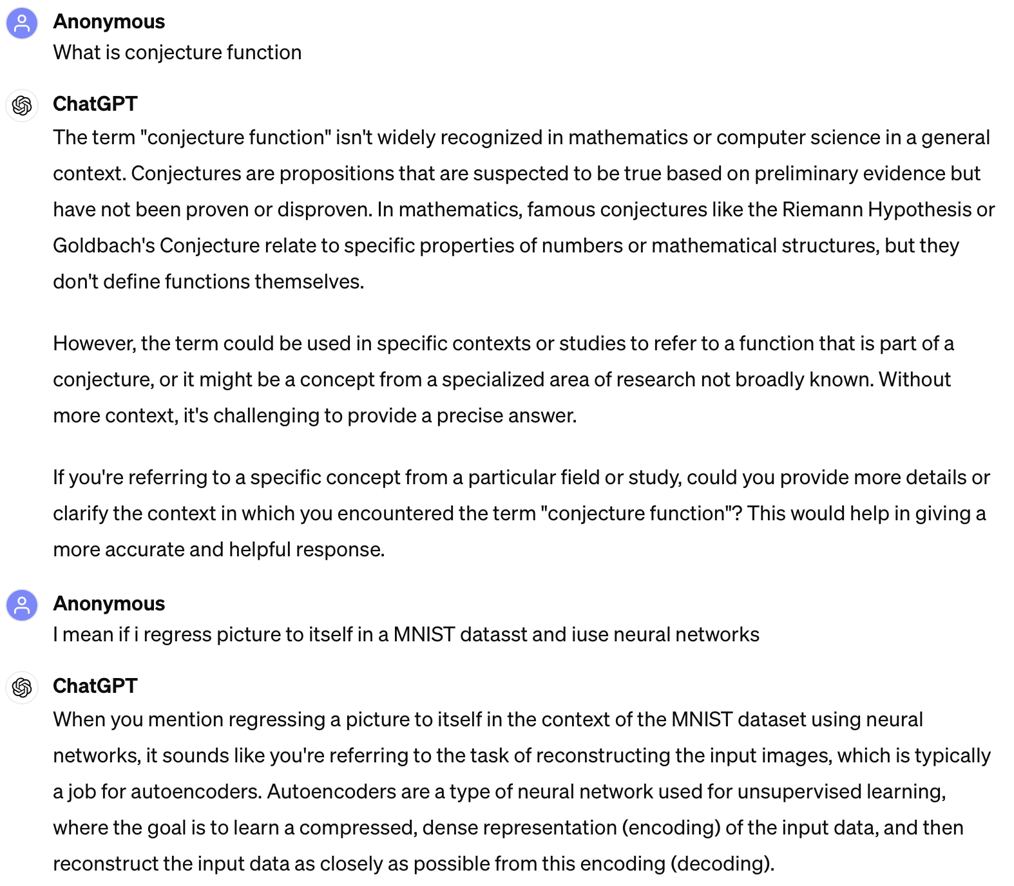
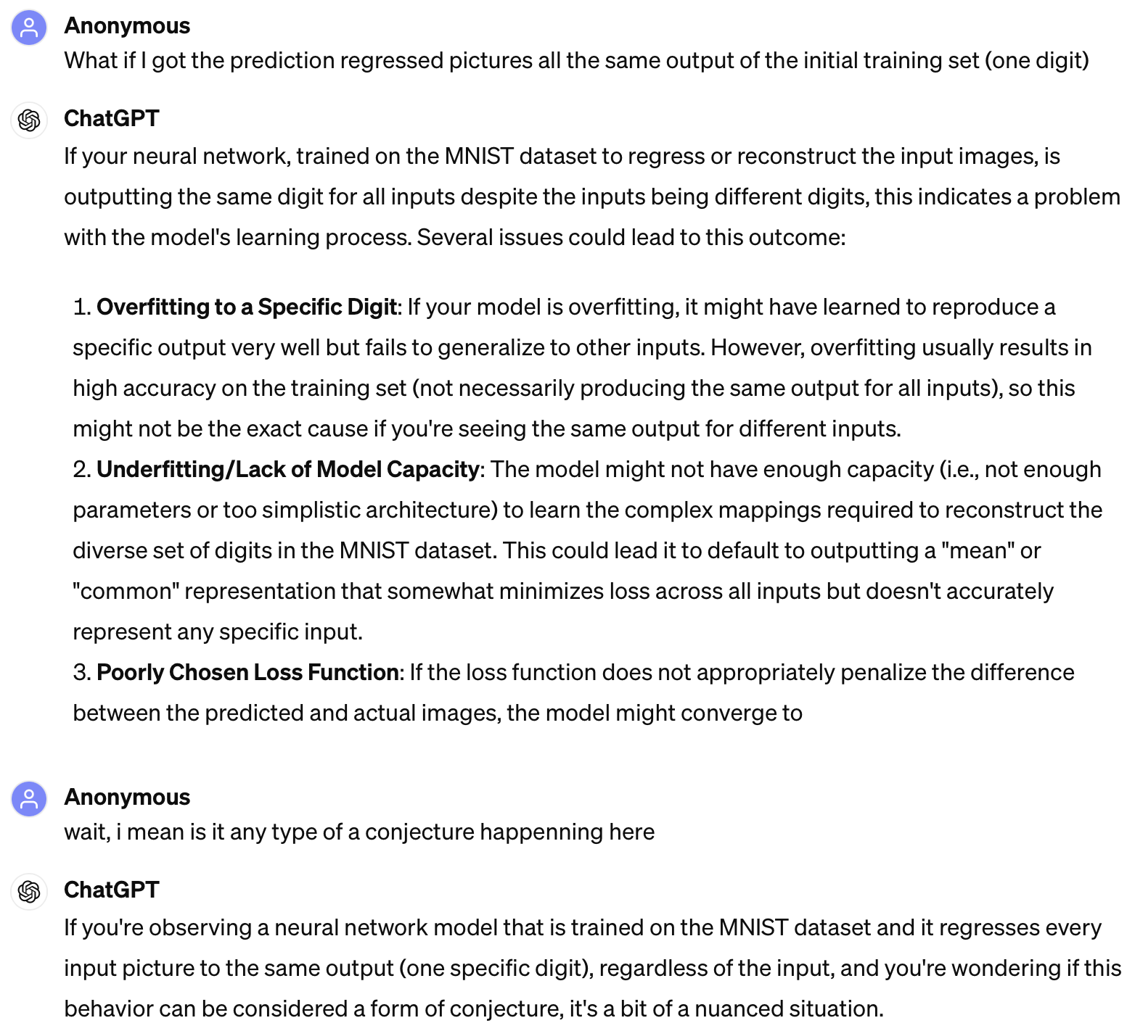
Sometimes a simple dictionary might solve many problems
Hard to see a bot telling you your question does not make sense

Slide 22
Chat logs from GENIAL: examples from quantitative MSc course
The "I will ask anything" student: used before attempting the assignment
Substitute of book or papers
Substitute of dictionary
Substitute of search engine
Substitute of thinking?
Bot is very polite, hard to see a clear statement
Does usually not admit question is not clear/contradictory
Hard to see "I don't know" or denying an answer when not sure​
False sense of security, reinforcement of your own ideas

Slide 23
(non-exhaustive list of) Existing policies and guidelines
(2018) The impact of artificial intelligence on learning, teaching, and education – policies for the
future. Joint Research Centre, European Commission Science and Knowledge Service [11]
(May 2023) Artificial intelligence and the future of teaching and learning – insights and
recommendations. Office of Educational Technology [12]
(October 2023) Generative artificial intelligence in education. UK Dept. of Education [13]
(2023) ChatGPT and artificial intelligence in higher education – quick start guide. UNESCO [14]
(2023) Technology in education – a tool on whose terms? UNESCO [15]
(February 2024) AI use in assessments: protecting the integrity of qualifications. Joint Council for
Qualifications [16]
(April 2024) LSE statement on Generative Artificial Intelligence and education [17]

Slide 24
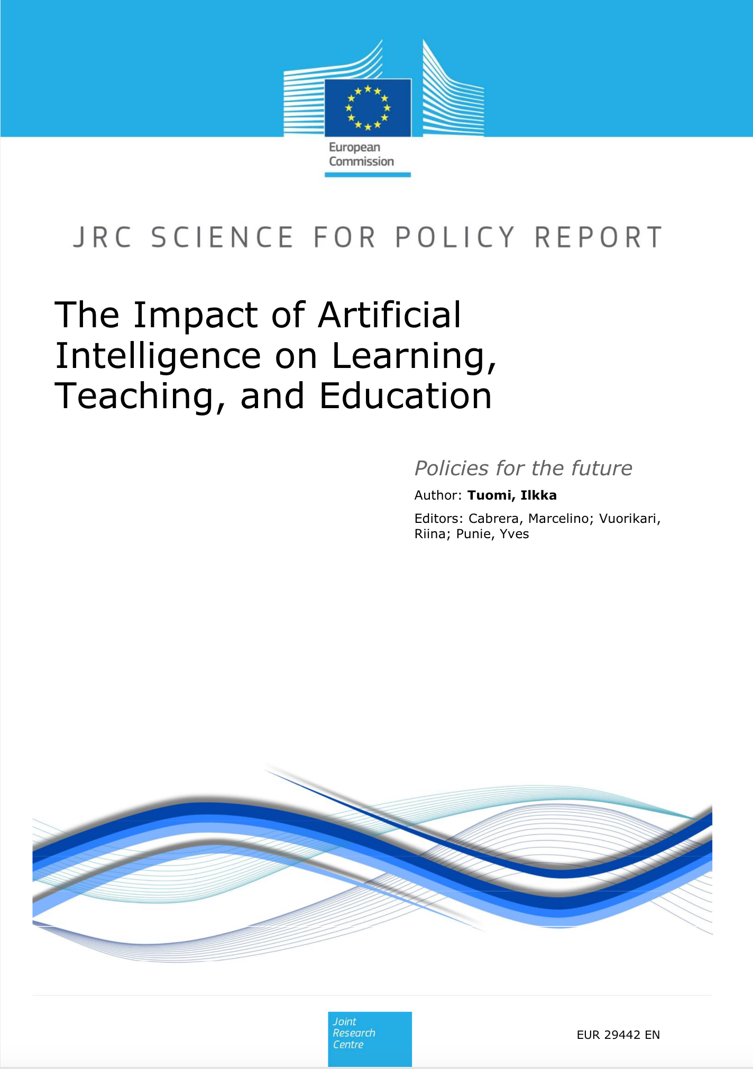
(2018)
Existing policies and guidelines
Context
"The impact of these technologies in practical educational settings has been relatively modest until recently. Technical developments over the recent years, however, suggest that the situation may be changing rapidly."
"it may be easy to think that AI is rapidly becoming super intelligent and gain all the good and evil powers awarded to it in popular culture. This, of course, is not the case. The current AI systems are severely limited, and there are technical, social, scientific, and conceptual limits to what they can do..."
Current developments and envisaged impact (at that time)
AI for automatic test generation and assessment
Computer-supported learning environments: diagnose student attention, emotion, and conversation dynamics
"No AI without UI" principle: collect real-time input from learner behaviour + historical data to model learner
Conversational natural language systems leading to teachable conversational agents
Need to create future-oriented models for education and teaching, to prevent AI from mechanising and reinventing outdated teaching practices.
The balance may shift from the instrumental role of education towards its more developmental role.
A general policy change is to increase educators' and policymakers' awareness of AI technologies and their impact.

Slide 25
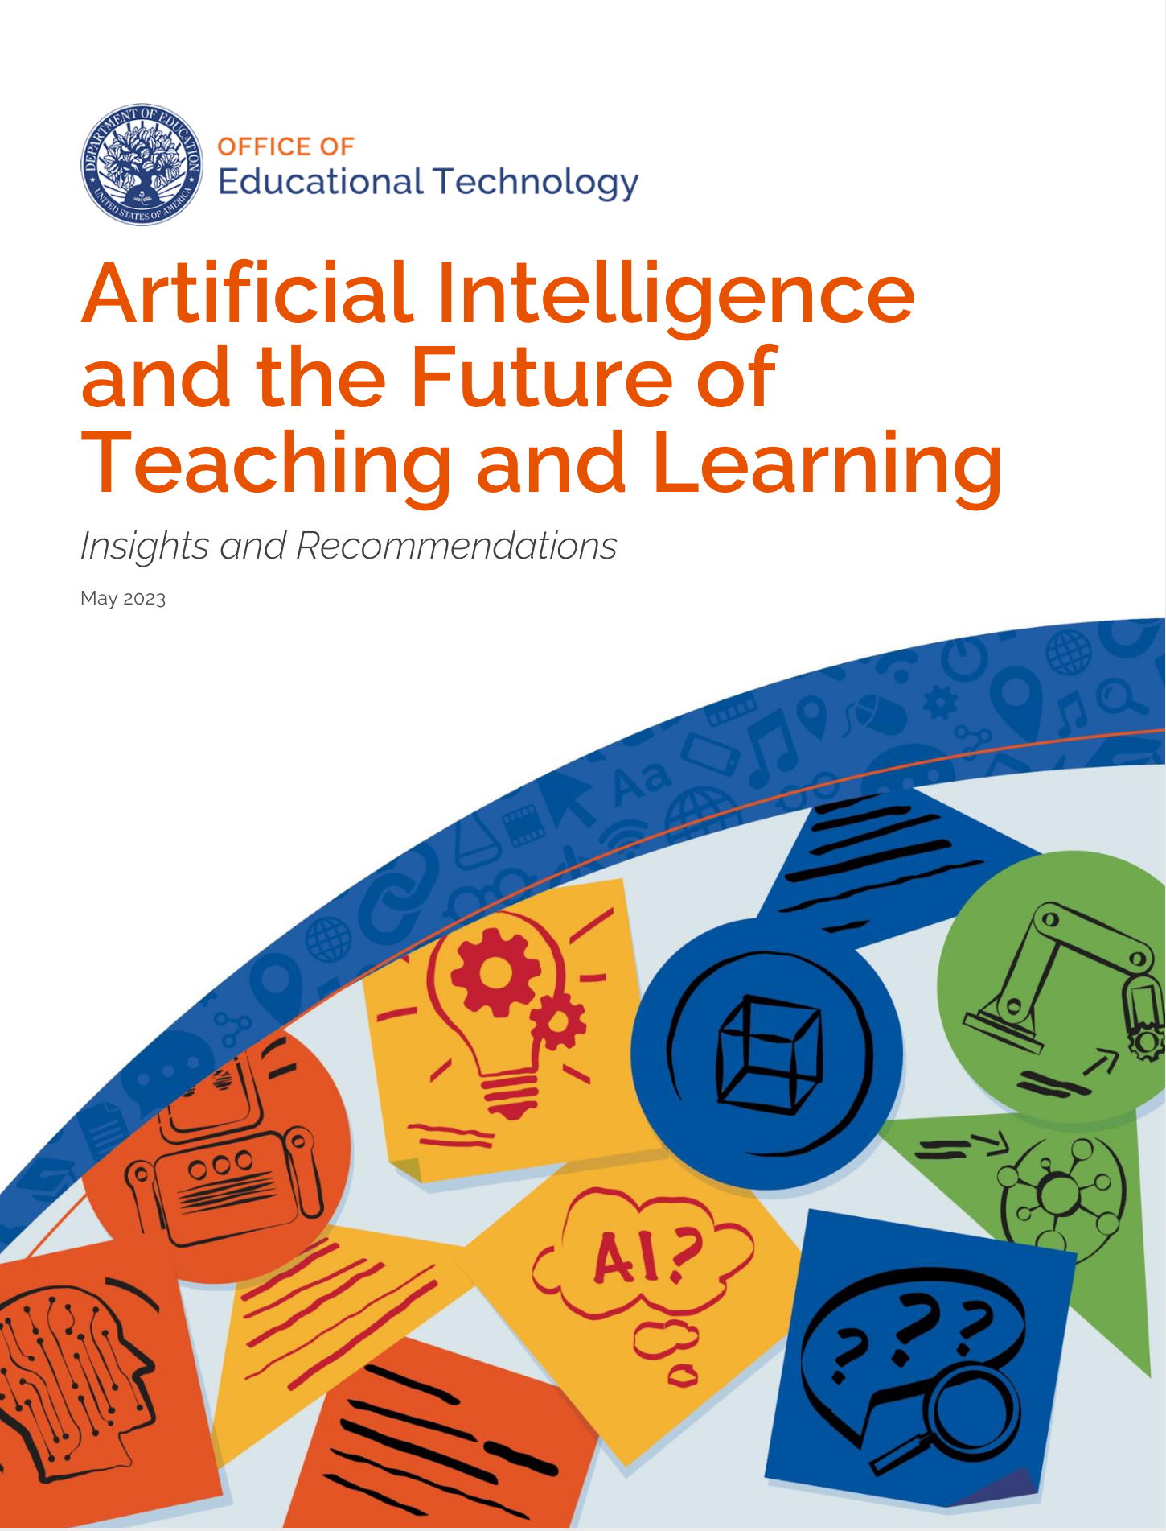
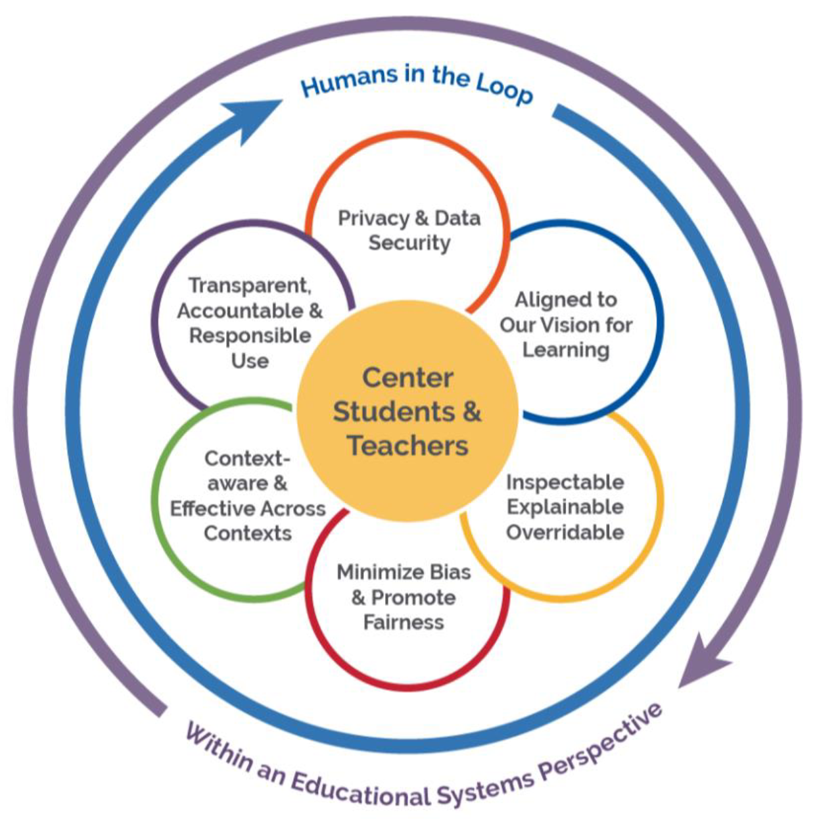
(2023)
Existing policies and guidelines
Context
Duality: learning with and about AI
"ACE (always center educators) in AI" practice => what are the loops in which teachers should be centered?
Balancing human and computer decision making
Recommendations
Emphasize humans in the loop ​​
Align AI models to a shared vision for education
Design using modern learning principles
Prioritise strengthening trust
Inform and involve educators
Focus R&D on enhancing trust and safety
Develop education-specific guardrails and guidelines
Desired qualities of
AI tools and systems
in education

Slide 26
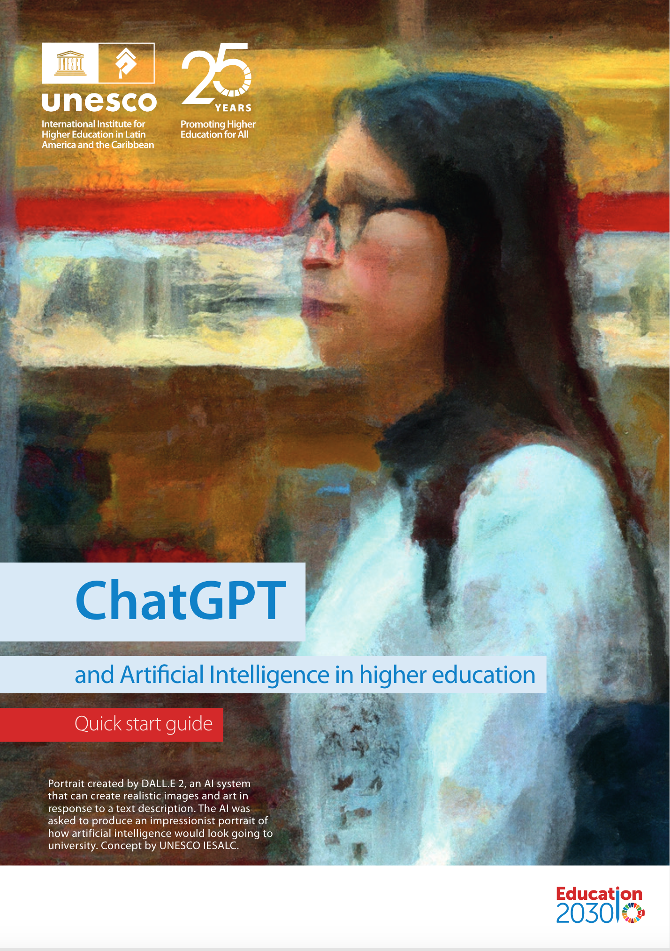
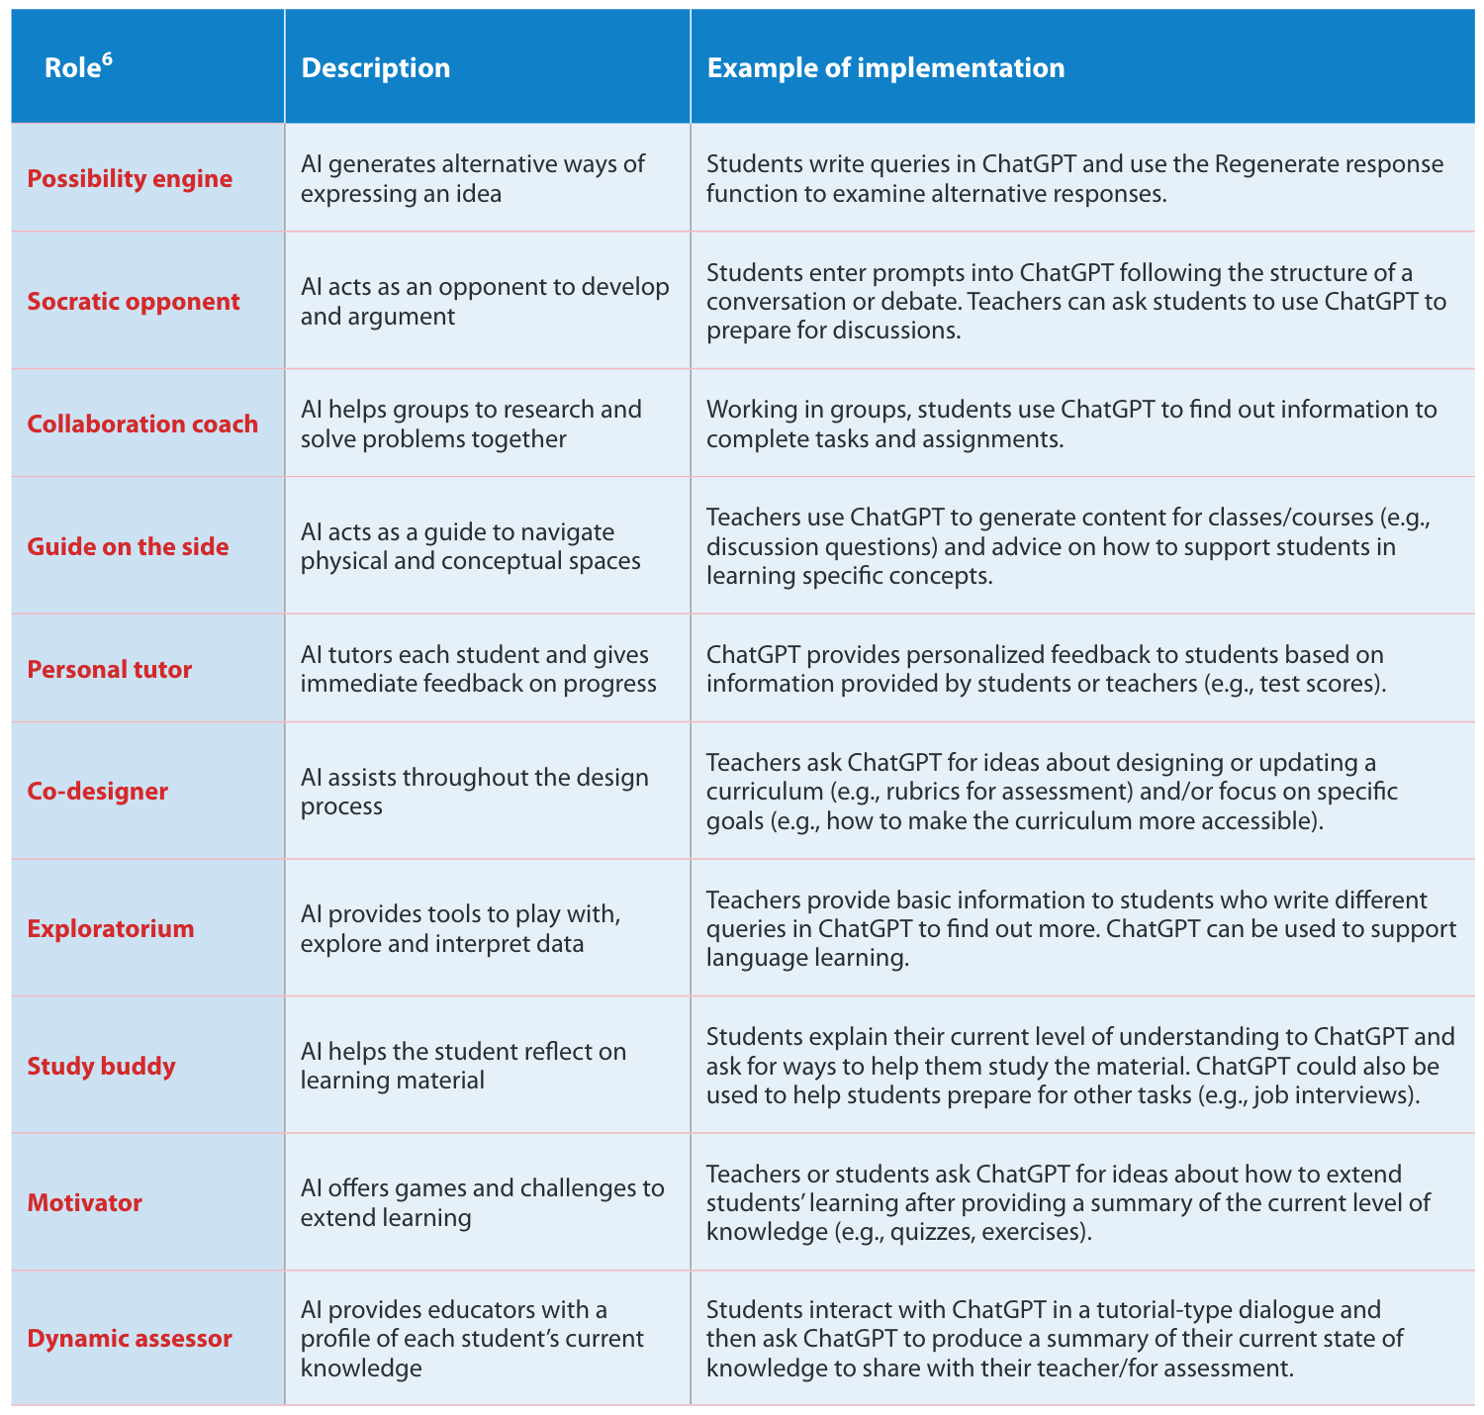
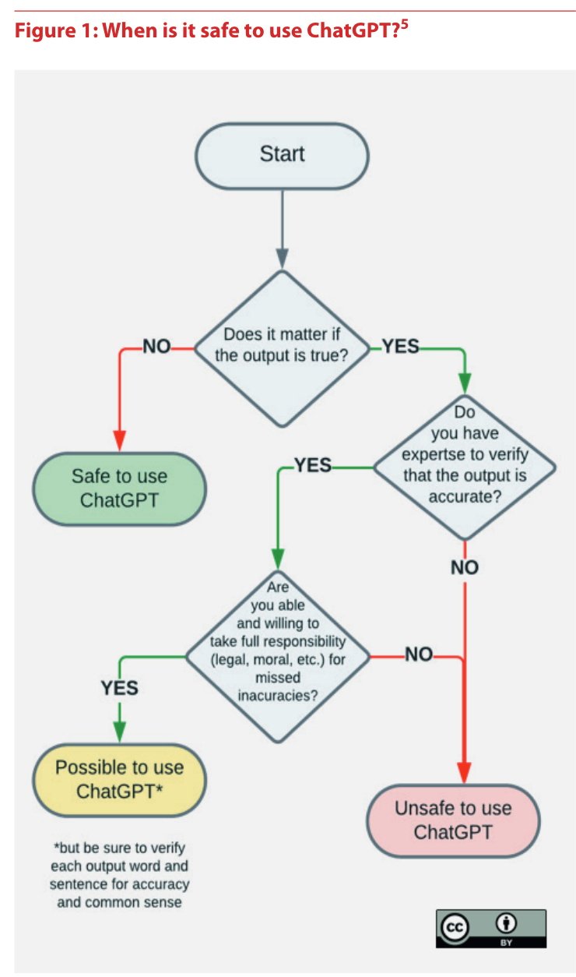
(2023)
Existing policies and guidelines
Recommendations
Use ChatGPT with care and creativity
Impact, guidance, learning outcomes, assessment, integrity and honesty
Build capacity to understand and manage AI
New programmes and courses, AI literacy, staff training, peer support
Conduct an AI audit
Understand, decide, and monitor
Teaching and learning

Slide 27
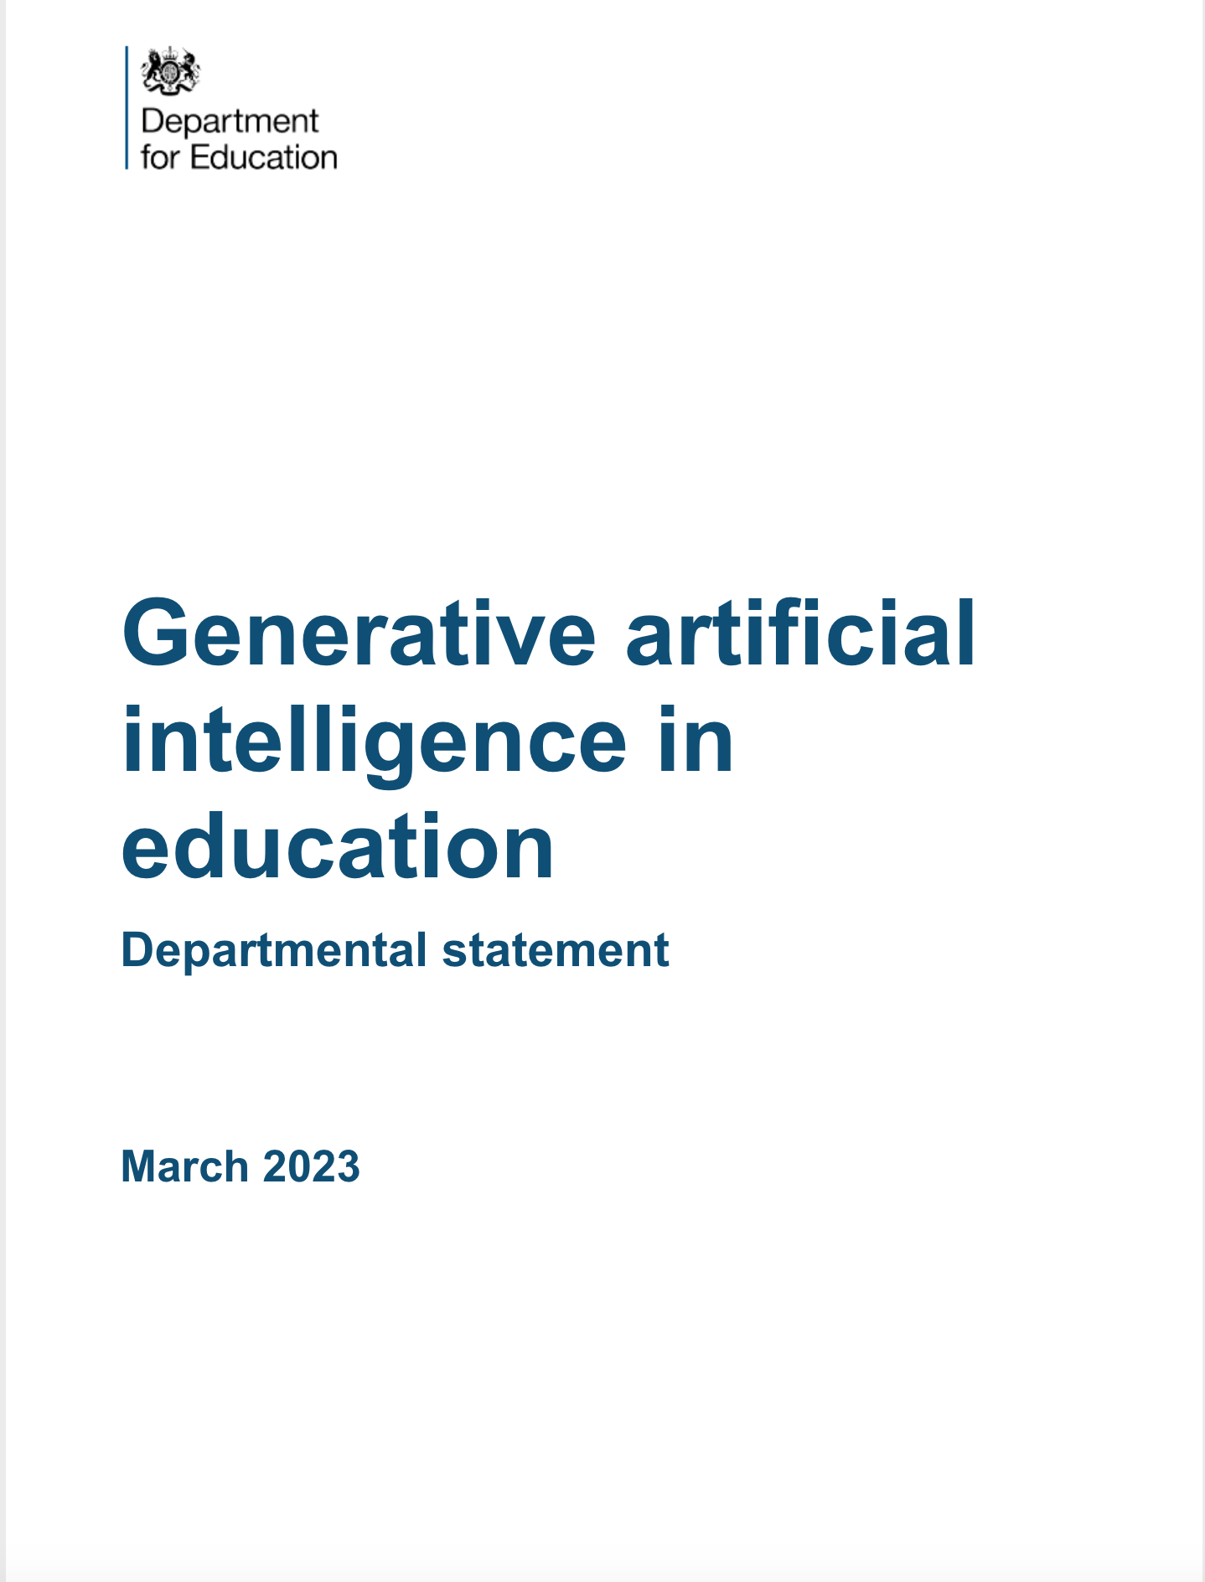
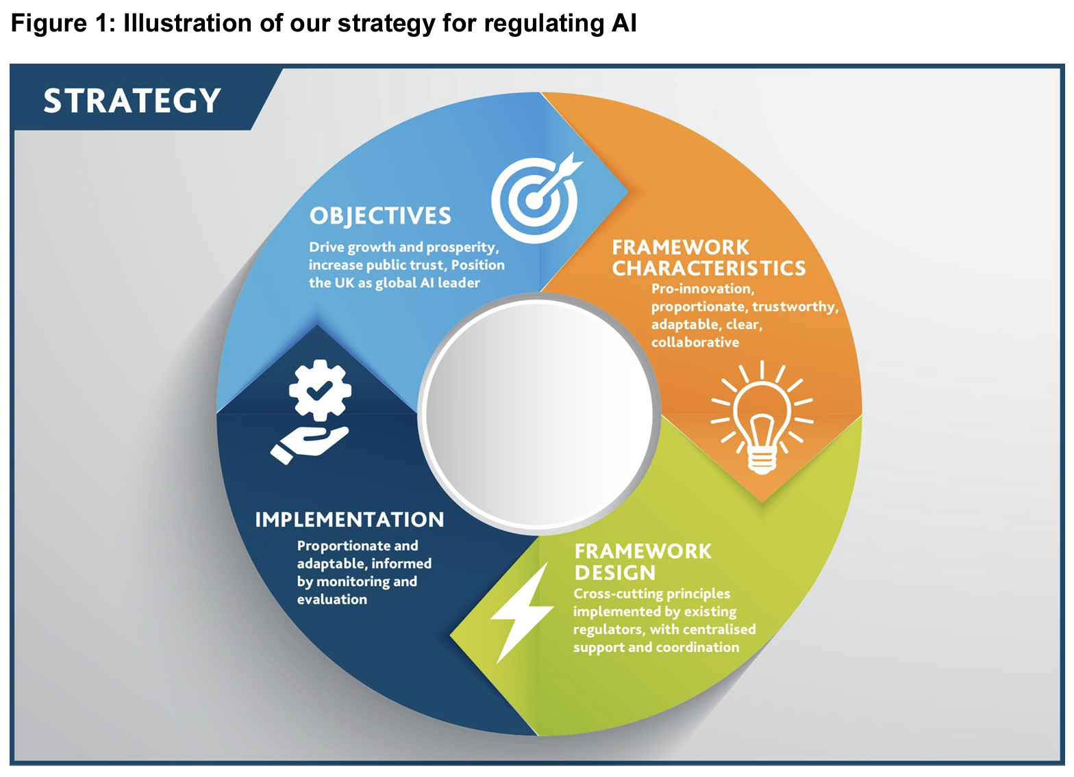
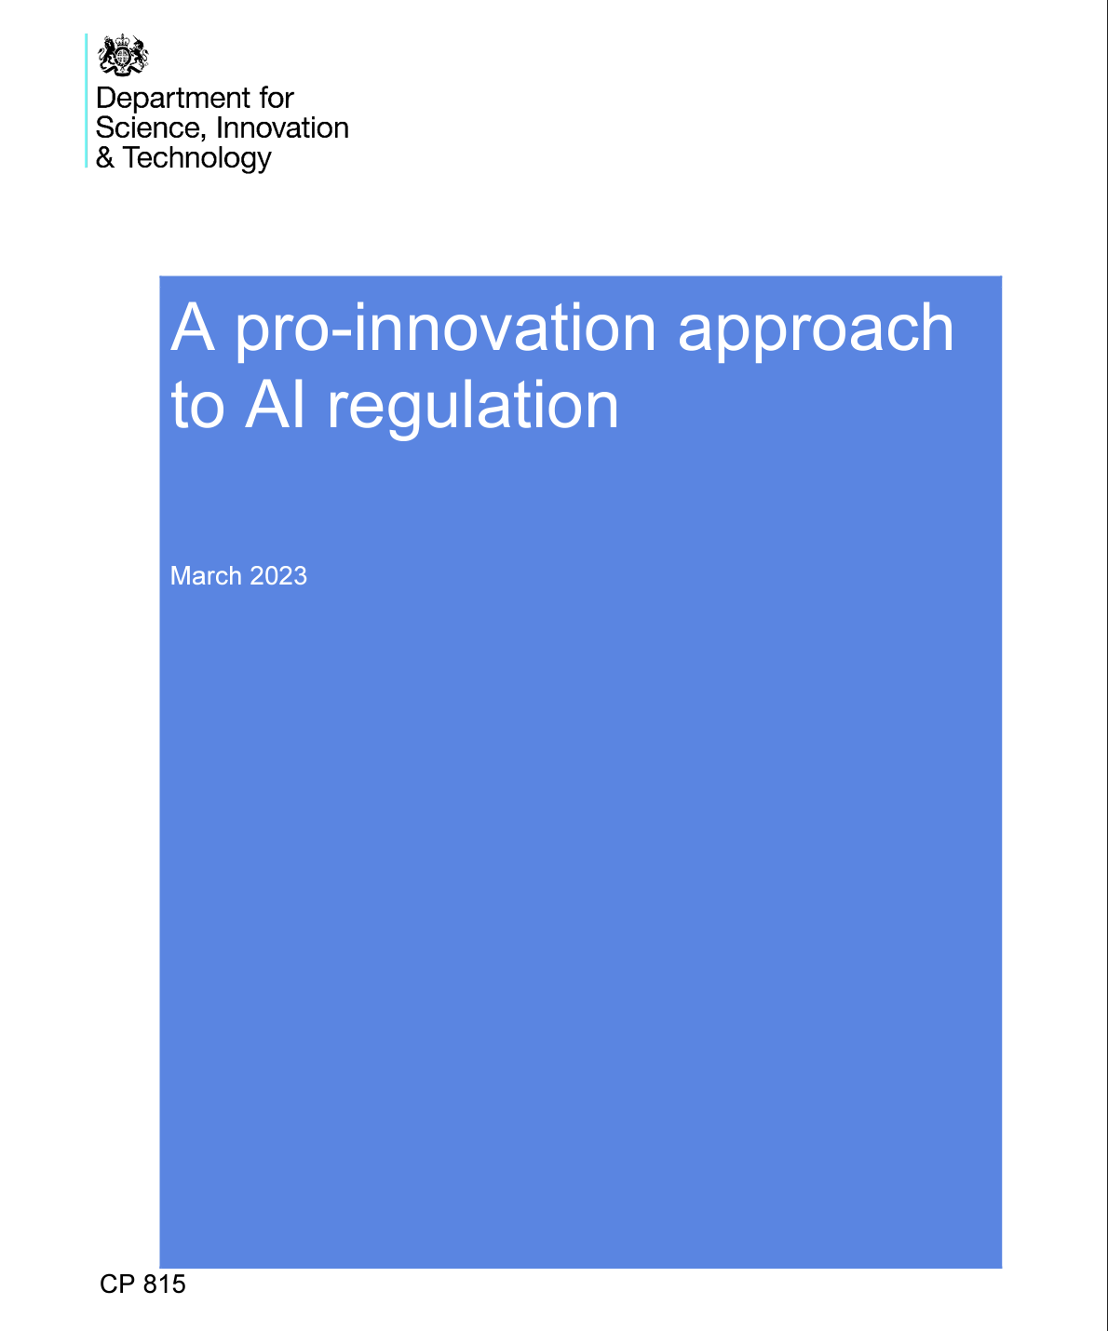
(2023)
Existing policies and guidelines
Key messages
Safety, security and responsible use of AI
Effective practice
Knowledge and skills for the future
Fairly and robust assessment system
Guiding principles for responsible development and use of AI
o Safety, security and robustness
o Appropriate transparency and explainability
o Fairness
o Accountability and governance
o Contestability and redress

Slide 28
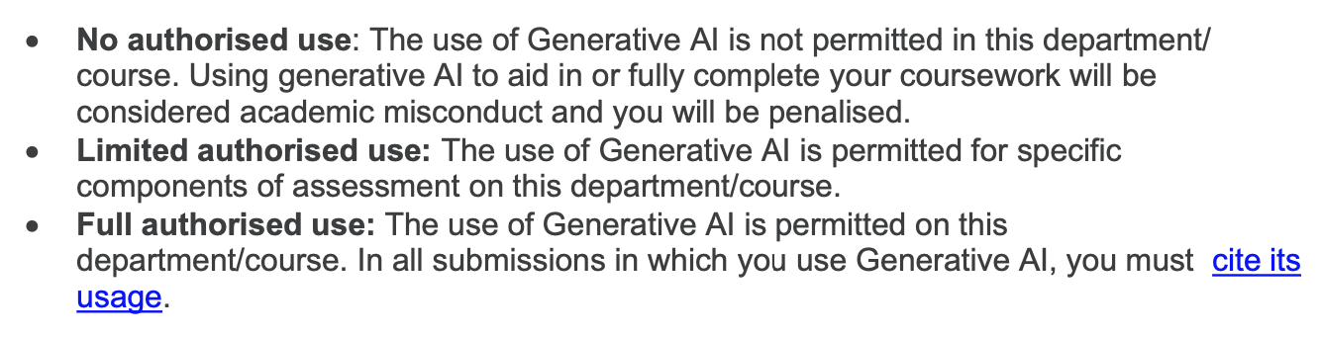
LSE existing guidelines
Teaching
Assessment
Departmental and/or course-level guidance on formative and summative assessment
What is acceptable and how this should be acknowledged in the submission
Research
Human in the loop at every stage
GenAI as assistant or copilot to enhance productivity for micro-level tasks
Researchers accountable for work produced by GenAI

Slide 29
What should we be aware of when designing a policy?
Academic misconduct
Widespread underreporting even when the policy allows usage without constraints
Very hard to prove academic misconduct, procedure hard to scale
Students' AI literacy
Students need to be aware of pitfalls of GenAI and how can they use it (if possible) to help with learning
Instructors' AI literacy and biases
Instructors need to design assignments assuming that most students will use GenAI
Courses on AI literacy: teaching about AI and teaching with AI
Instructors' strictness when marking [18]
Notes:
Integrating genAI into our pedagogy via classroom exercises and 202 discussions might address some of the concerns above, helping us to emphasize 203 thinking and writing as a method and process, and not merely an output

Slide 30
References
[1] Hopkins, S. On the air: Educational radio, its history and effect on literacy and educational technology. [link]
[2] Portway, P.; Lane, C. Guide to Teleconferencing and Distance Learning. 3 rd ed., Applied Business, 1997.
[3] Calculator Use and the SAT I Math. Research Notes. RN-16 https://eric.ed.gov/?id=ED562590
[4 ] Gamification [link]
[5] The Moodle story - https://moodle.com/about/the-moodle-story/
[6] Redit - https://en.wikipedia.org/wiki/Reddit
[7] Stack Overflow = https://stackoverflow.blog/2021/12/14/podcast-400-an-oral-history-of-stack-overflow-told-by-its-founding-team/
[8] Labadze, L., Grigolia, M. & Machaidze, L. Role of AI chatbots in education: systematic literature review. Int J Educ Technol High Educ 20, 56 (2023). https://doi.org/10.1186/s41239-023-00426-1
[9] UNESCO – ChatGPT and artificial intelligence in higher education. [link]
[10] Generative Artificial Intelligence for Education and Pedagogy. Cornell University. [link]
[11] JCR. The impact of Artificial Intelligence on learning, teaching, and education. [link]
[12] U.S. Department of Education, Office of Educational Technology, Artificial Intelligence and Future of Teaching and Learning: Insights and Recommendations, Washington, DC, 2023. [link]
[13] UK Department of Education. Generative artificial intelligence (AI) in education (policy paper) [link]
[14] UNESCO. ChatGPT and artificial intelligence in higher education: quick start guide. [link]
[15] UNESCO. Technology in education: a tool on whose terms? Global Education Monitoring Report. [link]
[16] Joint Council for Qualifications. AI Use in Assessments: Protecting the Integrity of Qualifications. [link]
[17] LSE – School statement on Generative Artificial Intelligence and education. [link]
[18] Farazouli, Alexandra, et al. "Hello GPT! Goodbye home examination? An exploratory study of AI chatbots impact on university teachers’ assessment practices." Assessment & Evaluation in Higher Education (2023): 1-13.

